Slide 1
How to get a Bag from College
CECS 450
By: Matthew Halderman , Sarah Santos, Jaelyn Garrard & Bonnie White

Slide 2
Table of contents
01
04
07
02
05
08
03
06
09
Salaries by Region
Salaries by College Type
Salaries by Major
Preparing & Cleaning
Preparing & Cleaning
Preparing & Cleaning
Exploration
Exploration
Exploration
Analysis
Analysis
Analysis

Slide 3
Preparing & Cleaning
Salaries by College Region

Slide 4
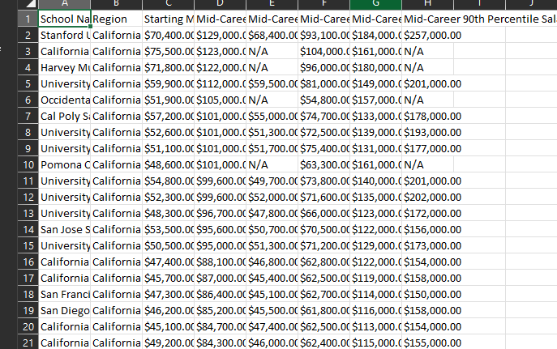
So we started here….
My dataset has been split into:
School Name
Region
Starting median salary
Mid-Career median salary
Then the 25th, 75th, and 90th percentile of the mid career salaries
Not bad, there are some issues

Slide 5
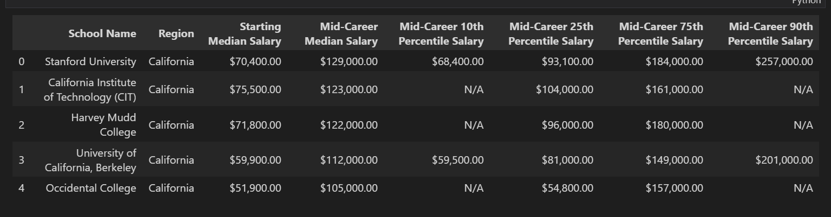
Got it into Jupyter Notebook and got it displaying here…
Issues:
$ signs in the numerical columns, some data types need changing
Some N/A Values
Mid size Dataset, around 300 rows total

Slide 6
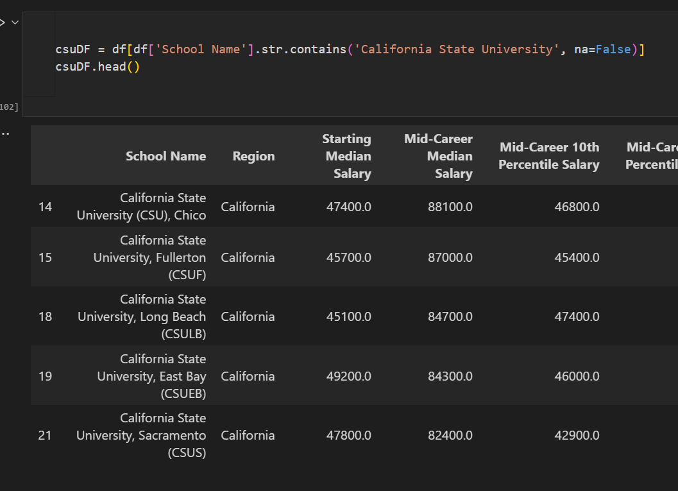

Fixed!
Finalized csv file
Changed columns with numerical values to float
Dropped unused columns

Slide 7
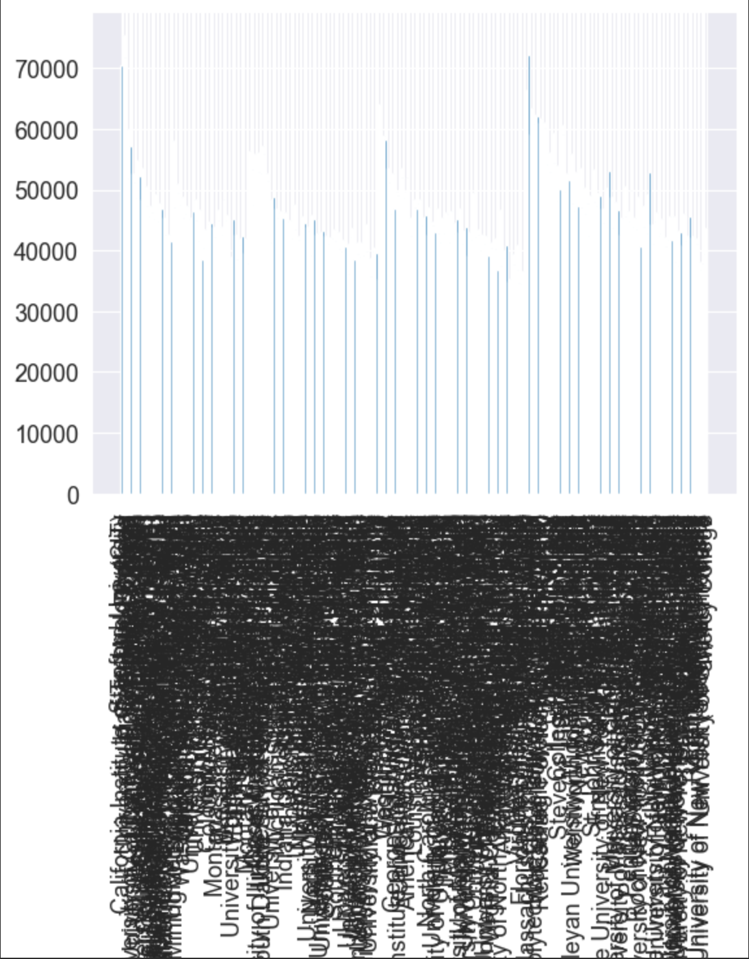
So… its graphing time!
… this was my first attempt
I had some work to do…

Slide 8
Exploring
College By Region

Slide 9
Thought Process
That graph had lots of data, visualizing it was not effective in this state
Splitting each entry by region was the best way to go, so I split by
CSUs
UCs
Western
Midwestern
Southern
Northeastern

Slide 10
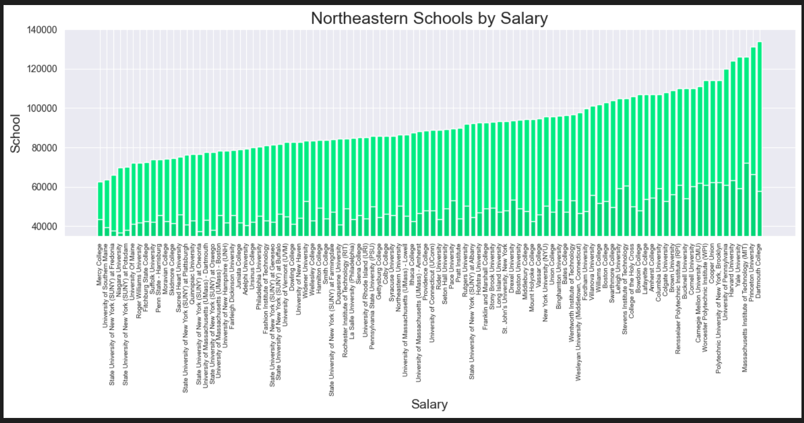
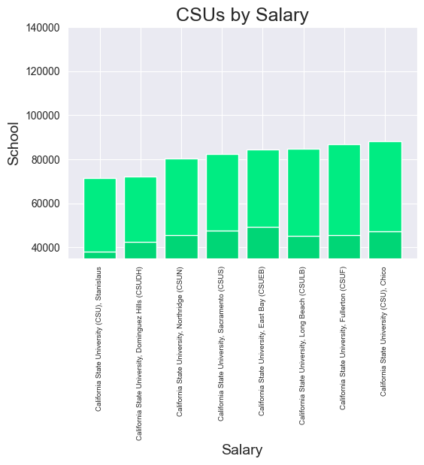
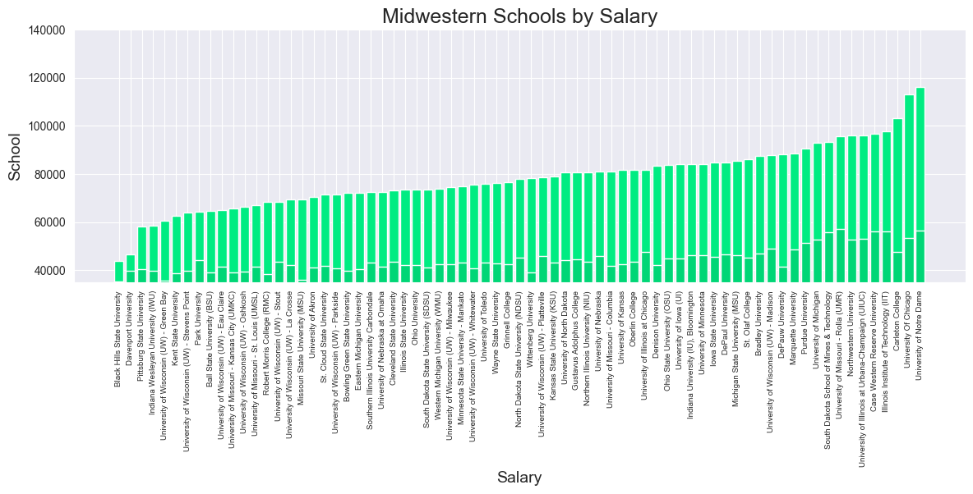
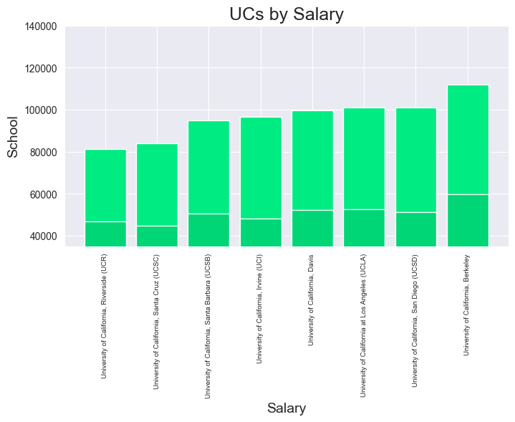
Initial Results
Nice layout, but still too many data points in some graphs

Slide 11
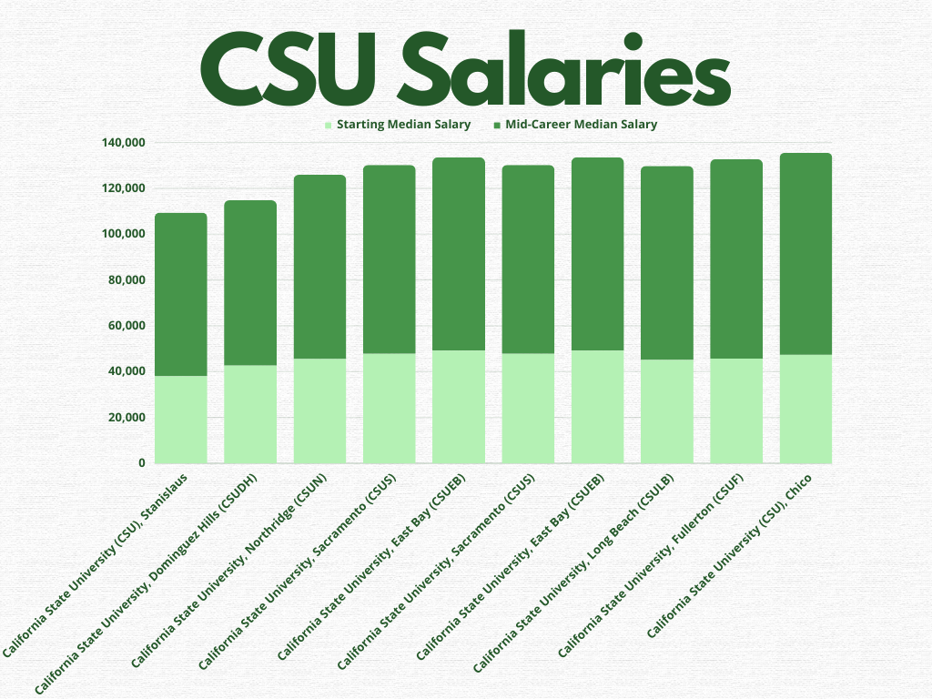
CSUs

Slide 12
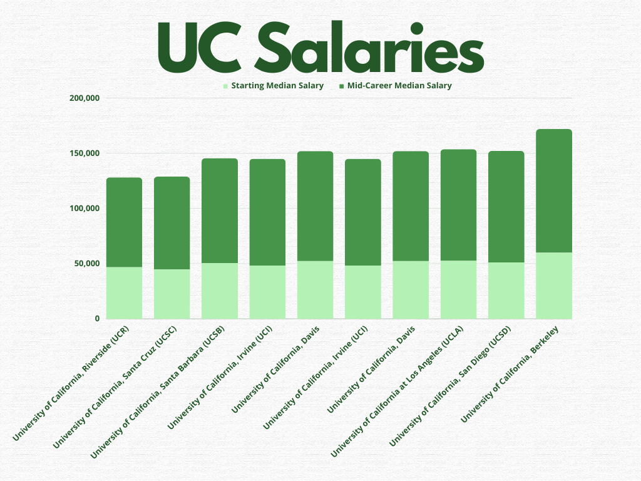

Slide 13
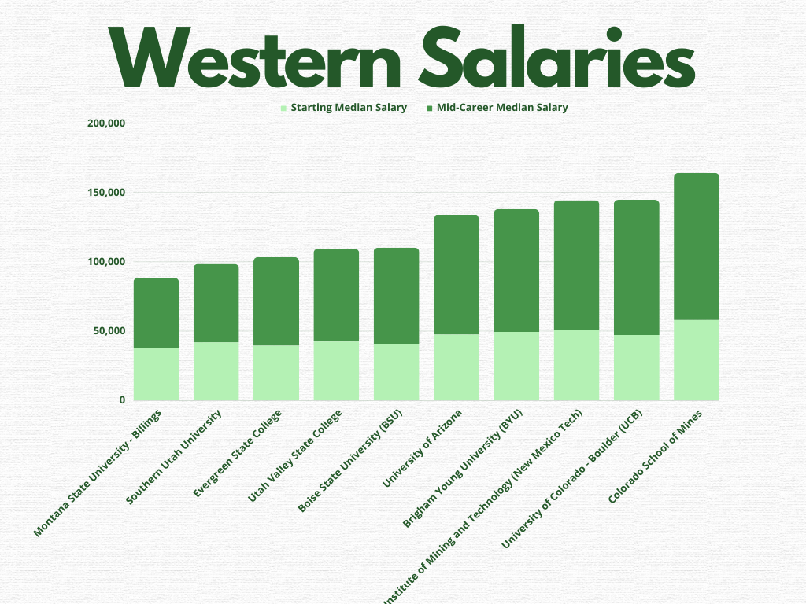
CSUs

Slide 14
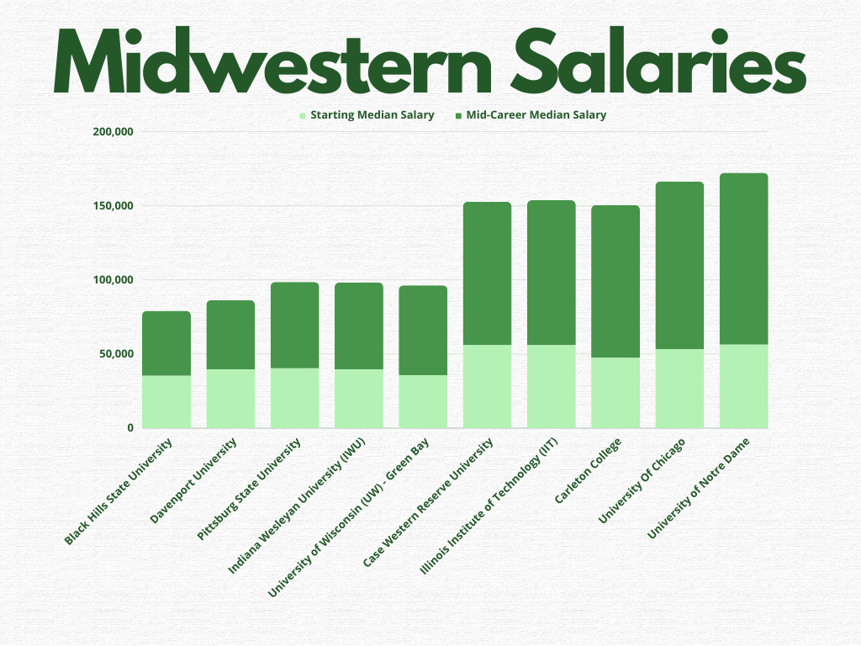
CSUs

Slide 15
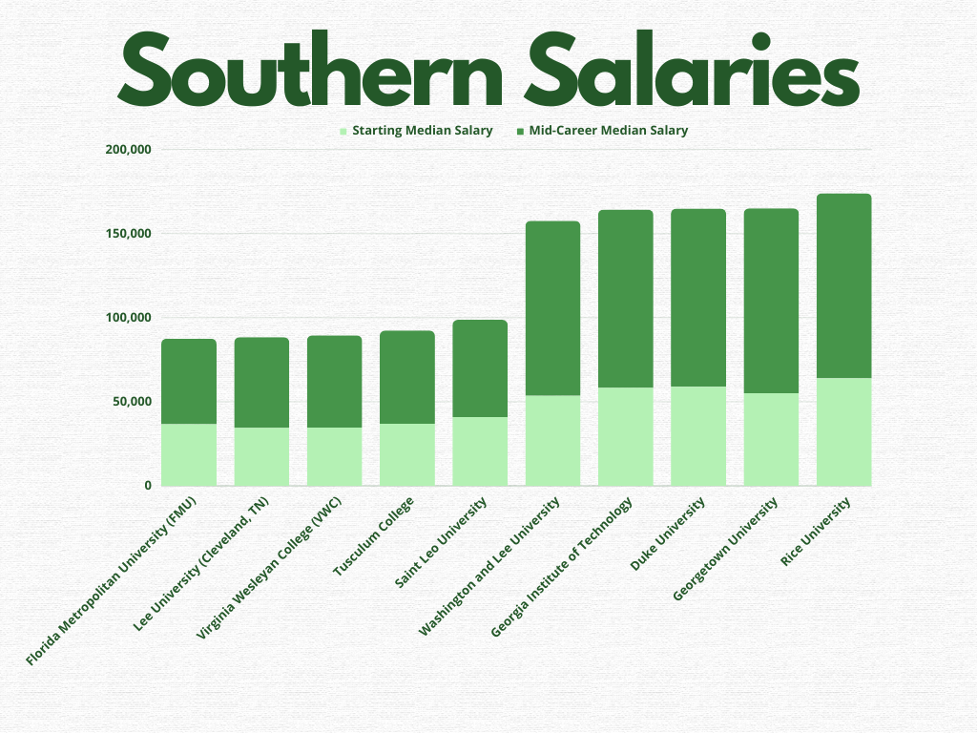
CSUs

Slide 16
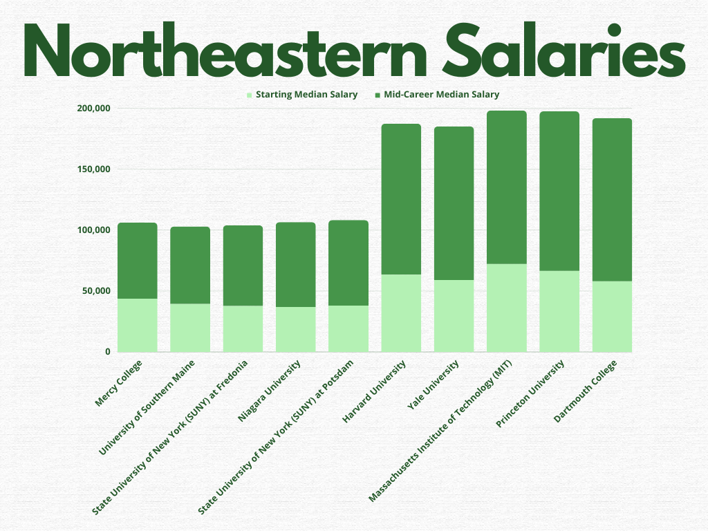
CSUs

Slide 17
Starting Salary
College by Region

Slide 18
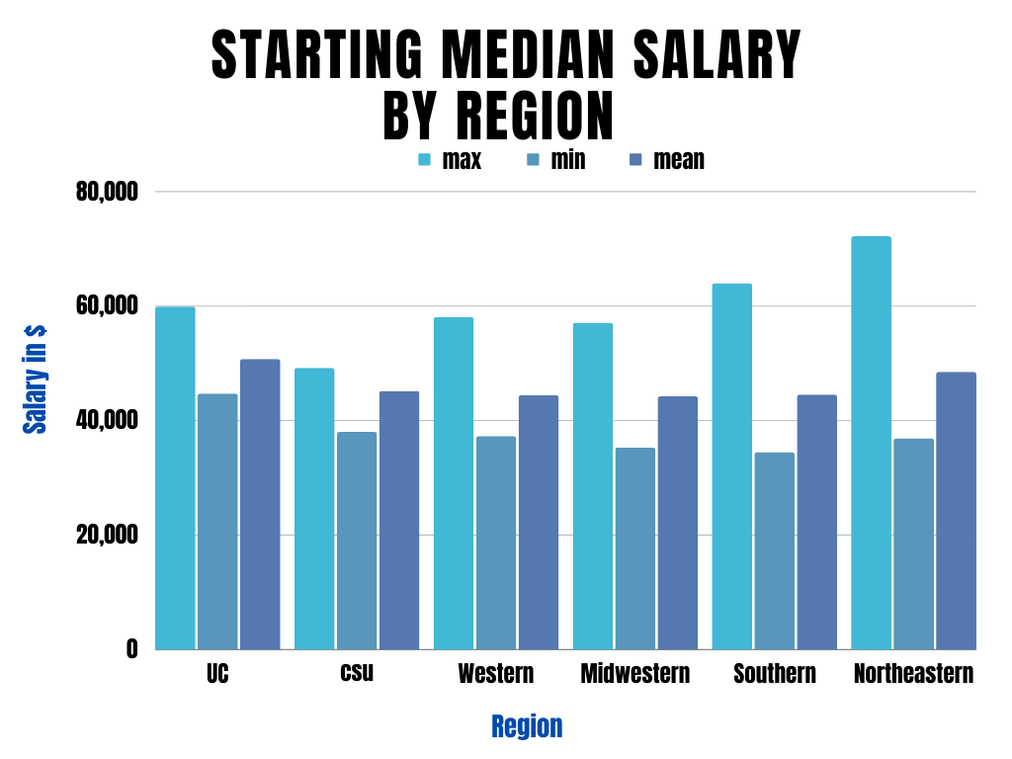
Pic of graph
Starting Salary Stats
Northeastern is the clear winner for maximum sal
UCs do very well on average
The rest are okay, sitting around 45k / year on average

Slide 19
Mid-Career Salary
College by Region

Slide 20
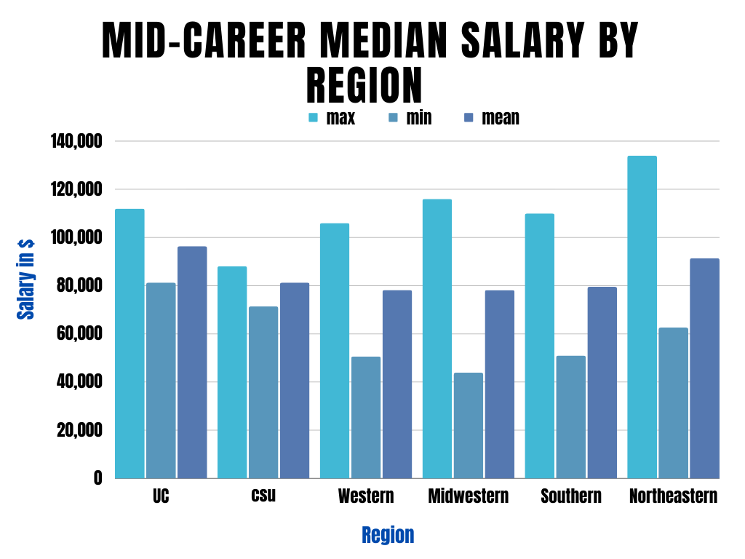
Mid-Career Salary Stats
Northeastern schools are still doing the highest at their best school
Midwestern is the lowest performing region
CSU’s pull ahead a little in the later years
Insert pic of graph here

Slide 21
Analysis
College By Region

Slide 22
Takeaways from Salaries by Region
The northeastern schools the place to be
This is probably because a reflection of the many Ivy League Schools in the region
The UCs are a close second
The midwestern & southern regions perform the worst
This definitely supports things like lower cost of living and lower minimum wage.
CSUs are right in the middle

Slide 23
Preparing & Cleaning
College Type Data

Slide 24
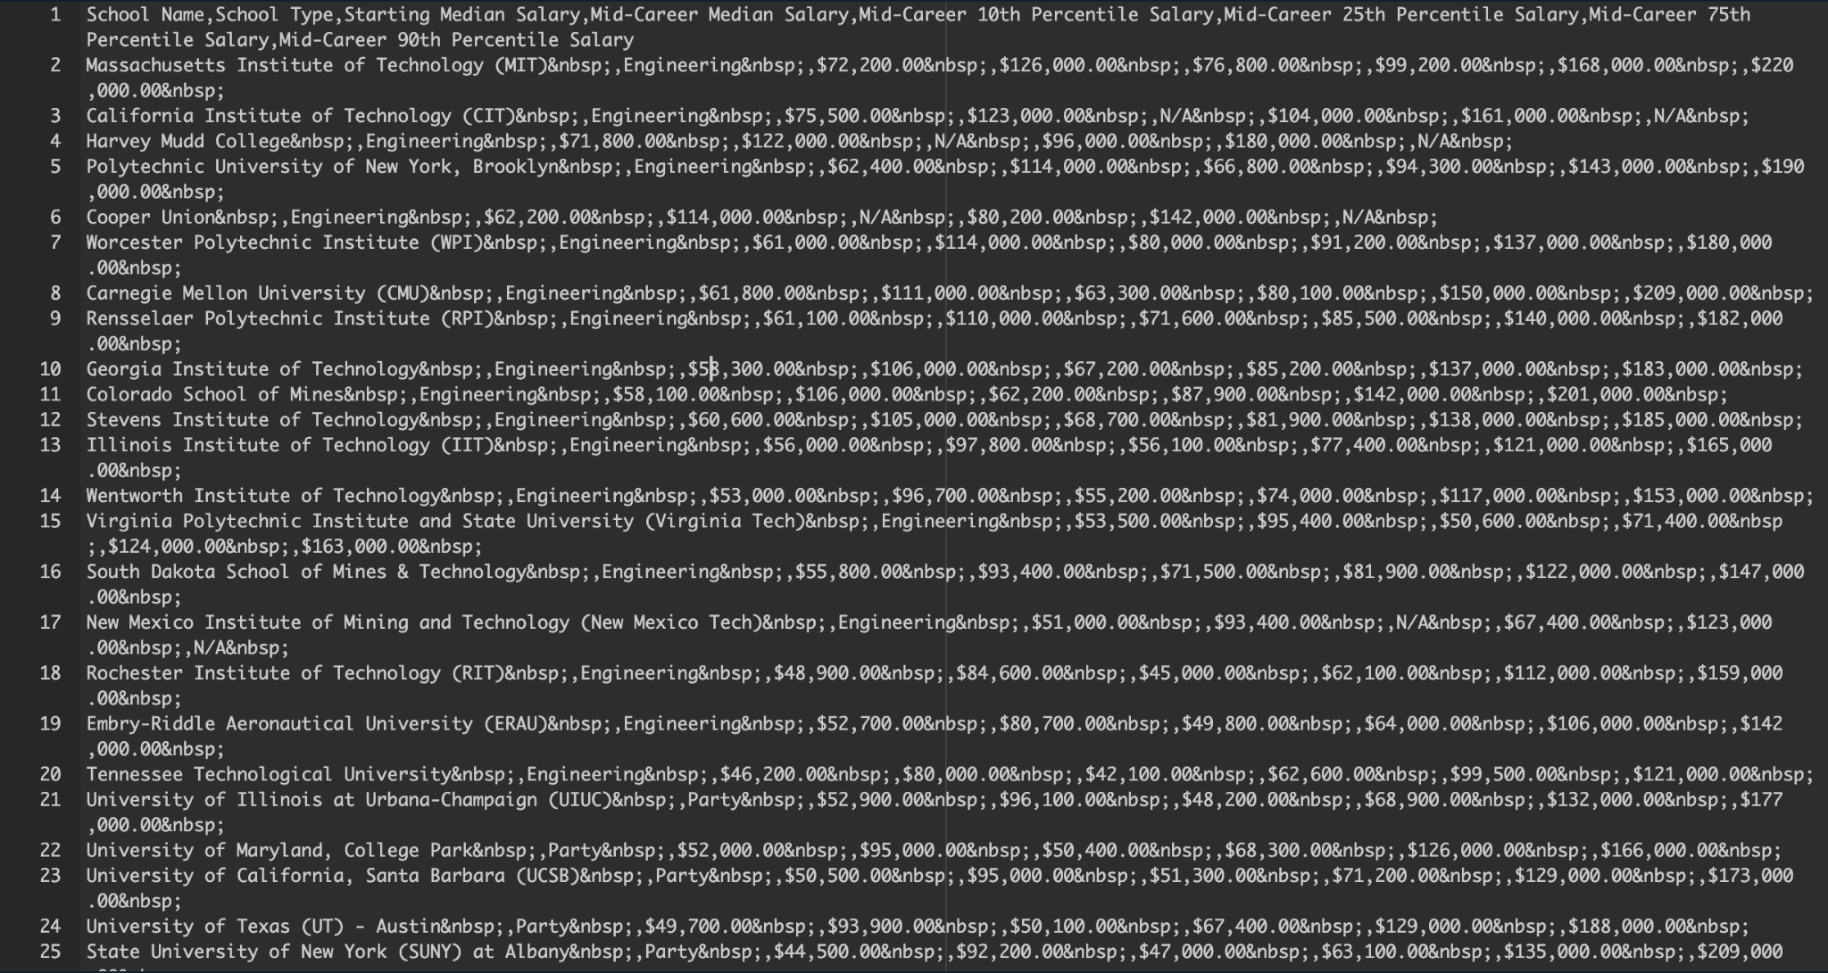
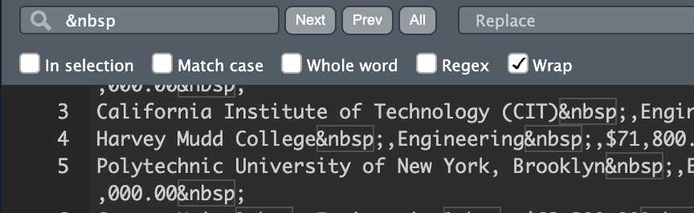

Slide 25
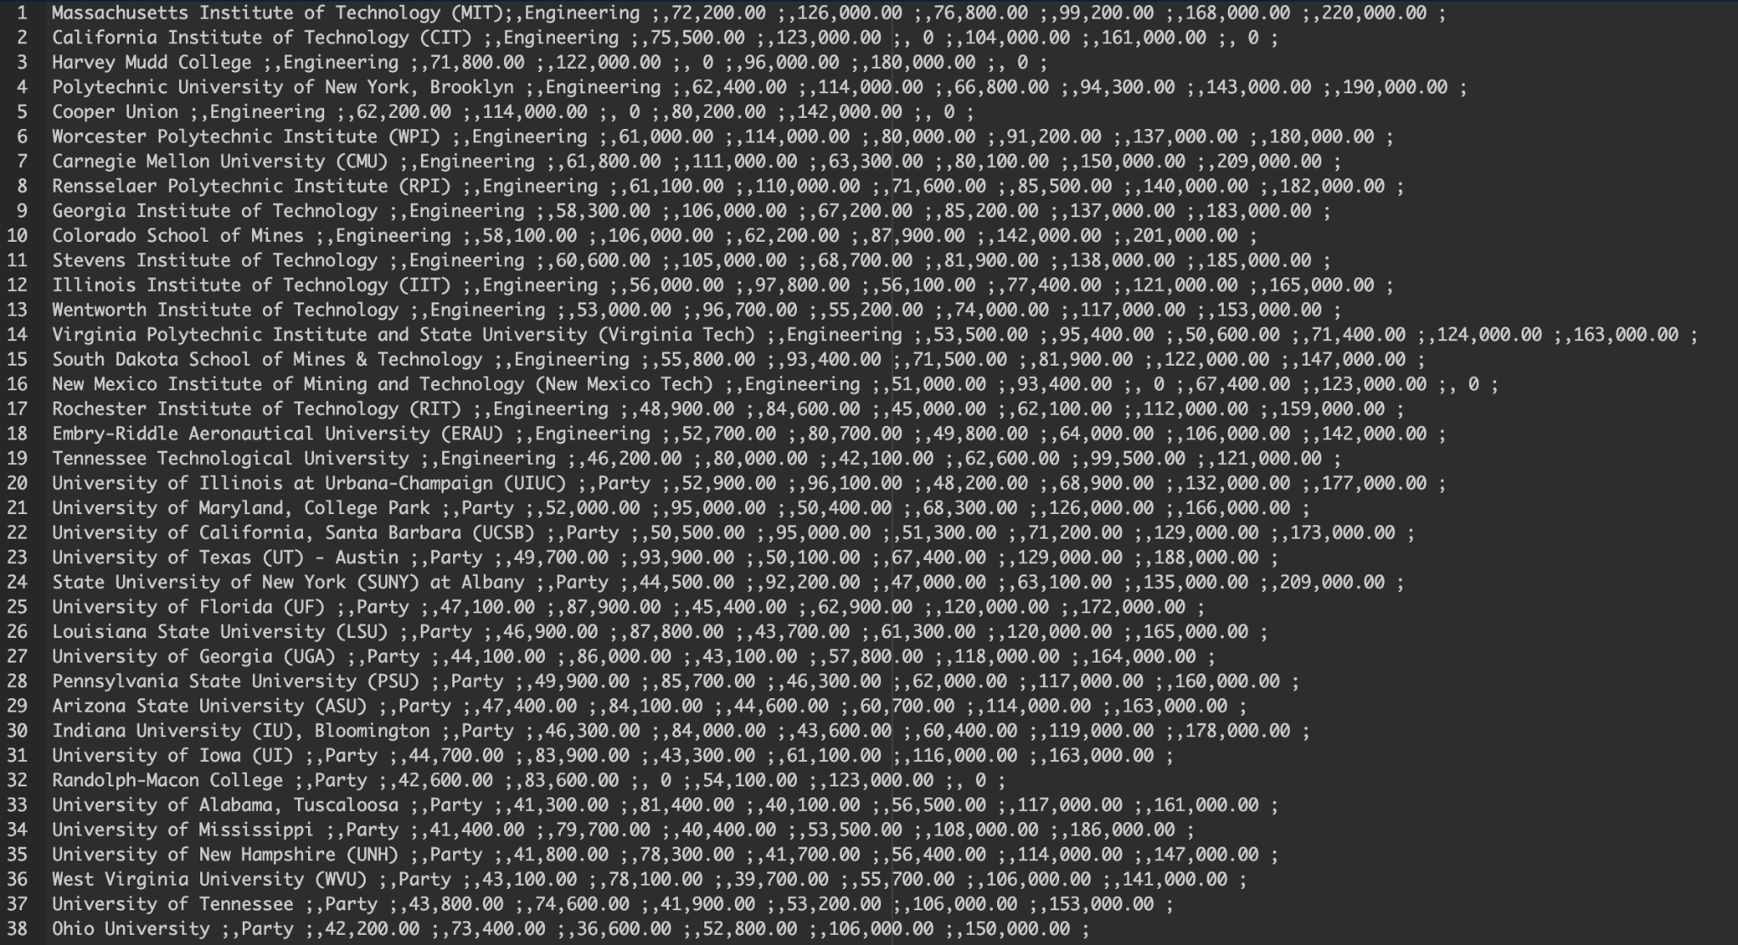

Slide 26
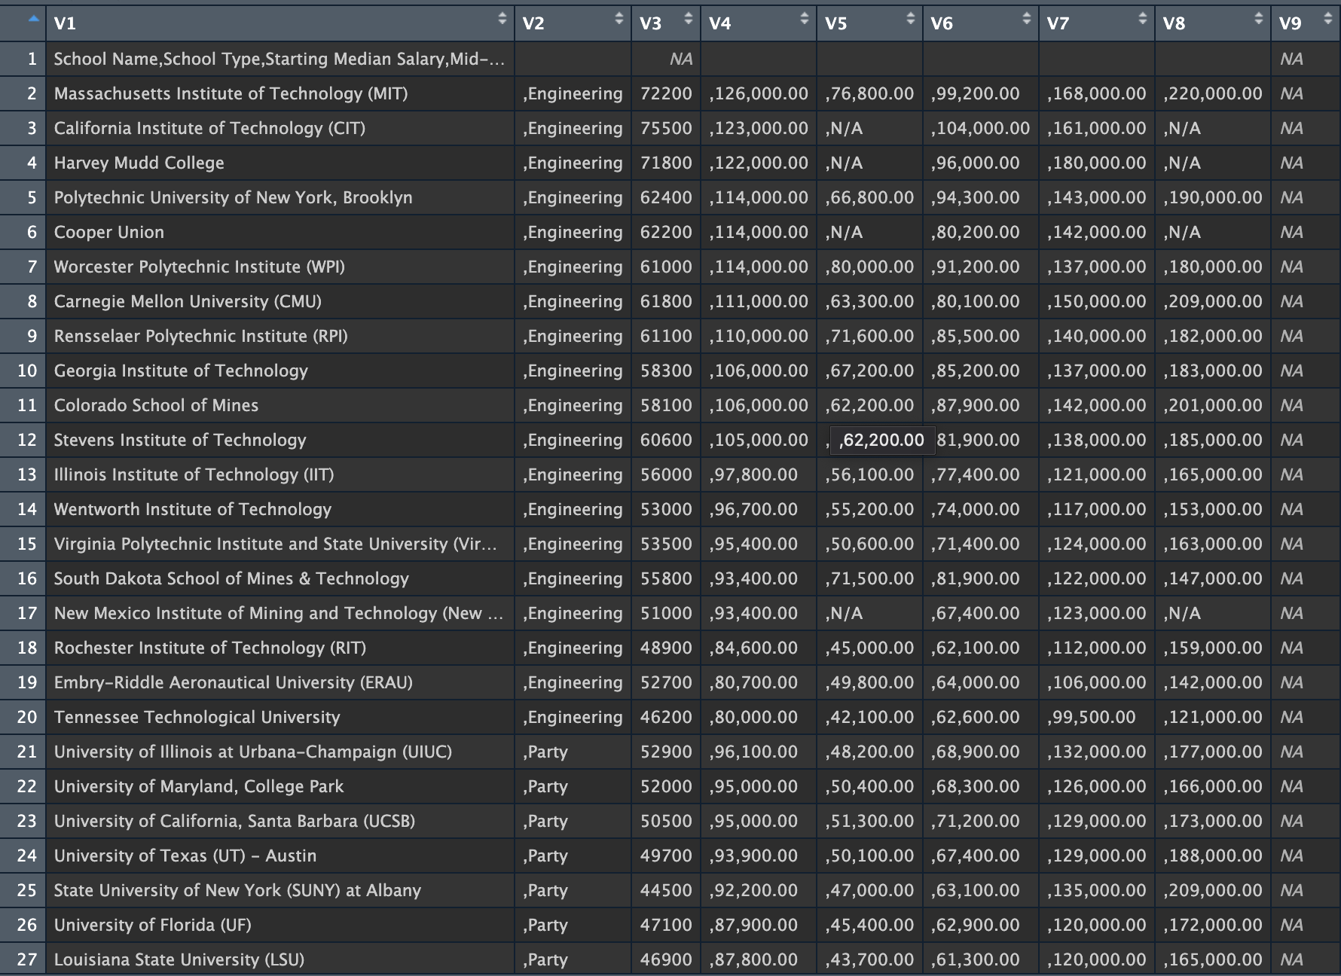

Slide 27
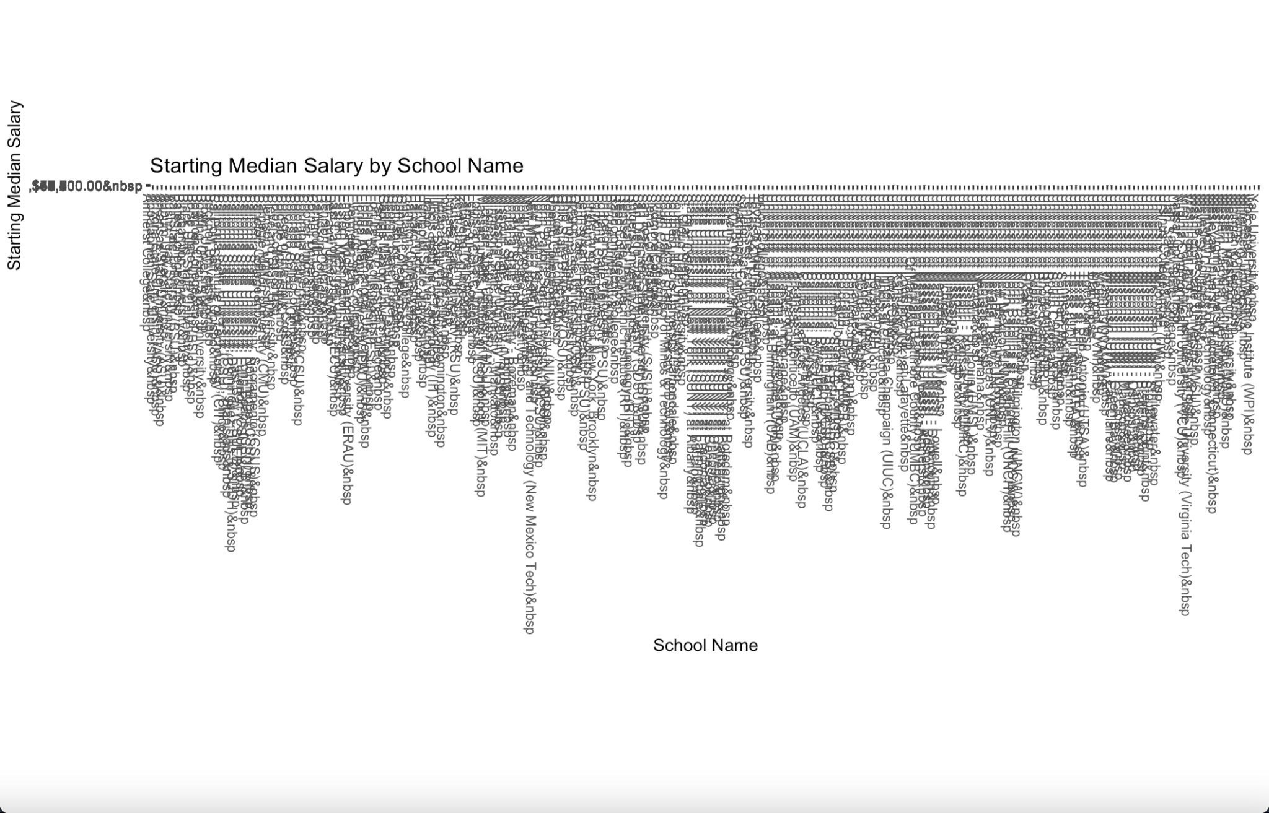

Slide 28
Exploring
College Type Data

Slide 30
Starting Salary
By College Type

Slide 31
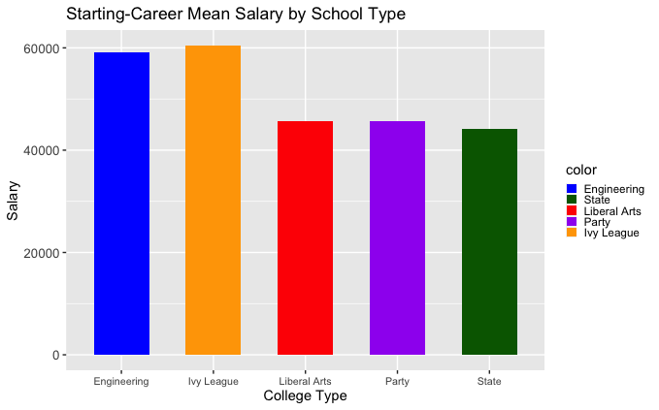
Starting Salary Stats
Engineering - $59,057.89
Ivy League - $60,475
Liberal Arts - $45,746.81
Party - $45,715
State - $44,126.29

Slide 32
Mid-Career Salary
By College Type

Slide 33
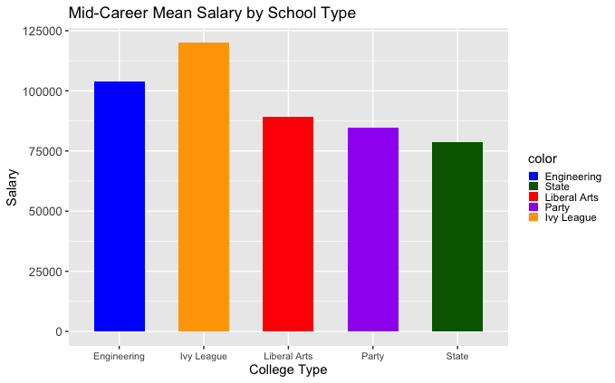
Mid-Career Salary Stats
Engineer - $103,842.10
Ivy League - $120,125
Liberal Arts - $89,378.72
Party - $84,685
State - $78,567.43

Slide 34
Analysis
By College Type

Slide 35
Takeaways from Salaries by College Type
Ivy League universities should statistically give you the best salary for your education
Graduating from a specialized/career-focus college will bring in a higher income than the average state universities
State universities (personally) surprised me as the lowest salaries for college types
Don’t underestimate the Party schools

Slide 36
Preparing & Cleaning
Salaries by College Major

Slide 37
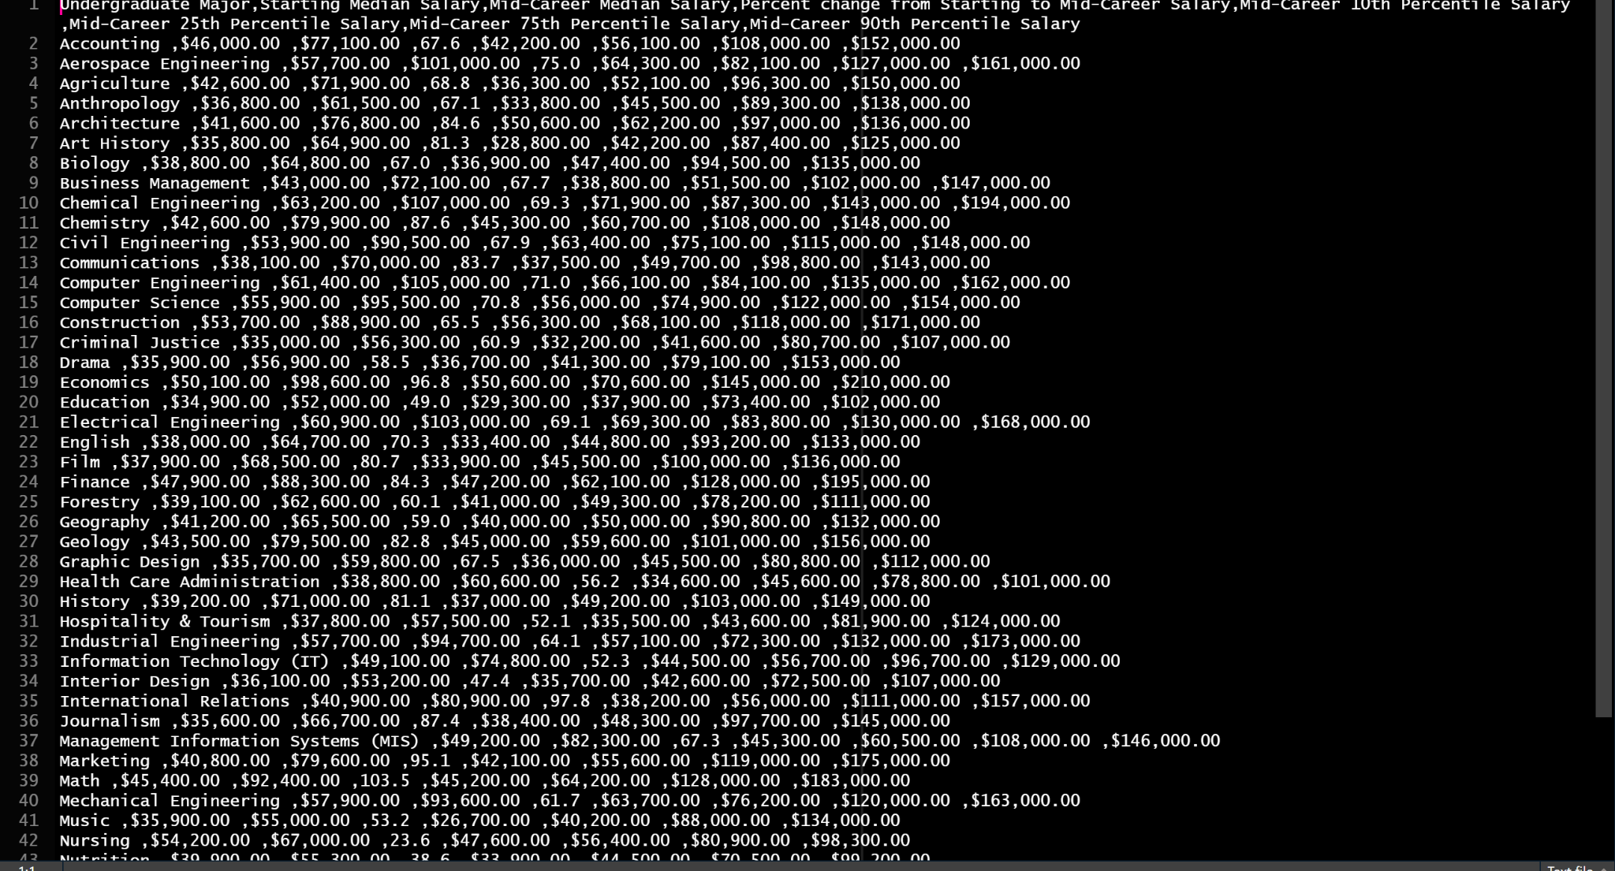

Slide 38
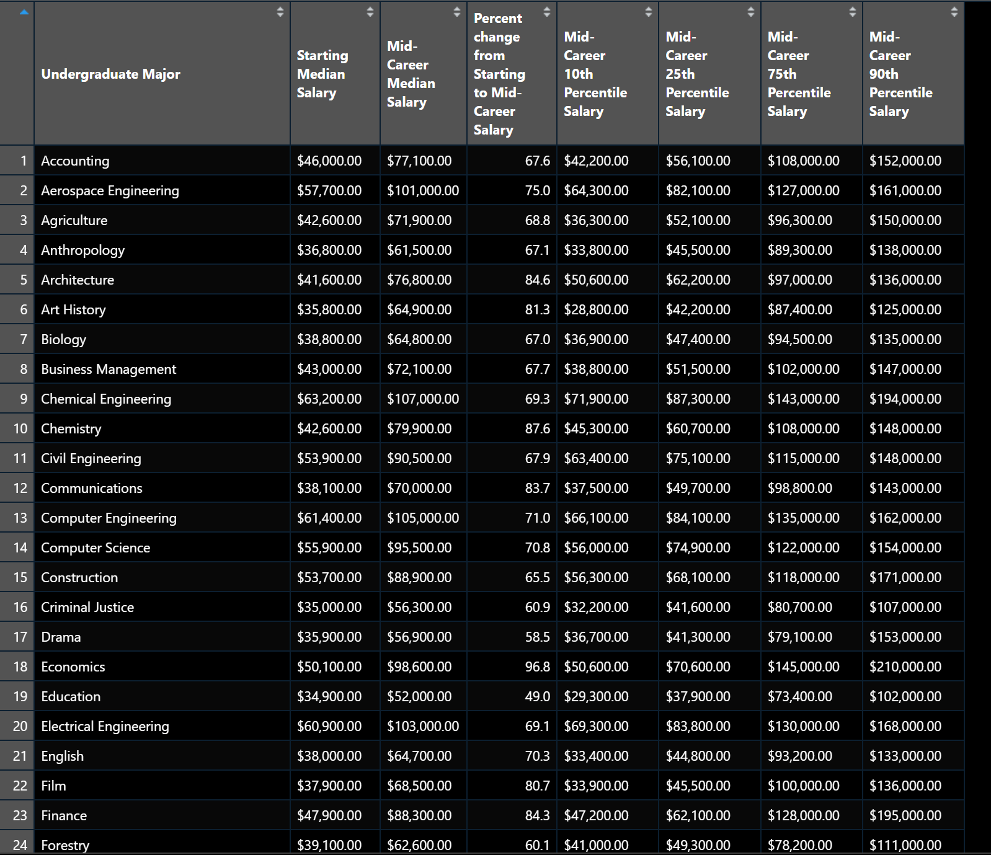

Slide 39
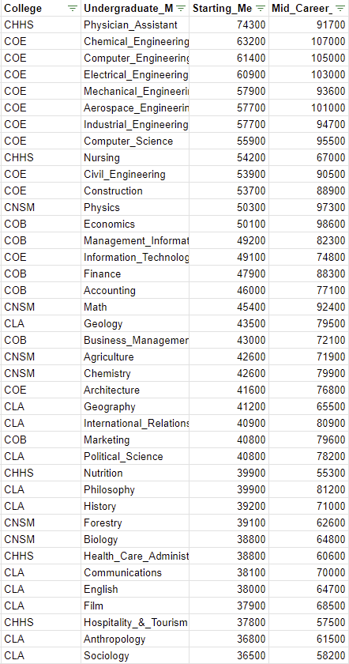
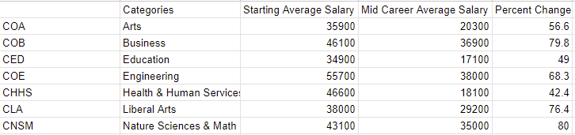
Trimming the data

Slide 40
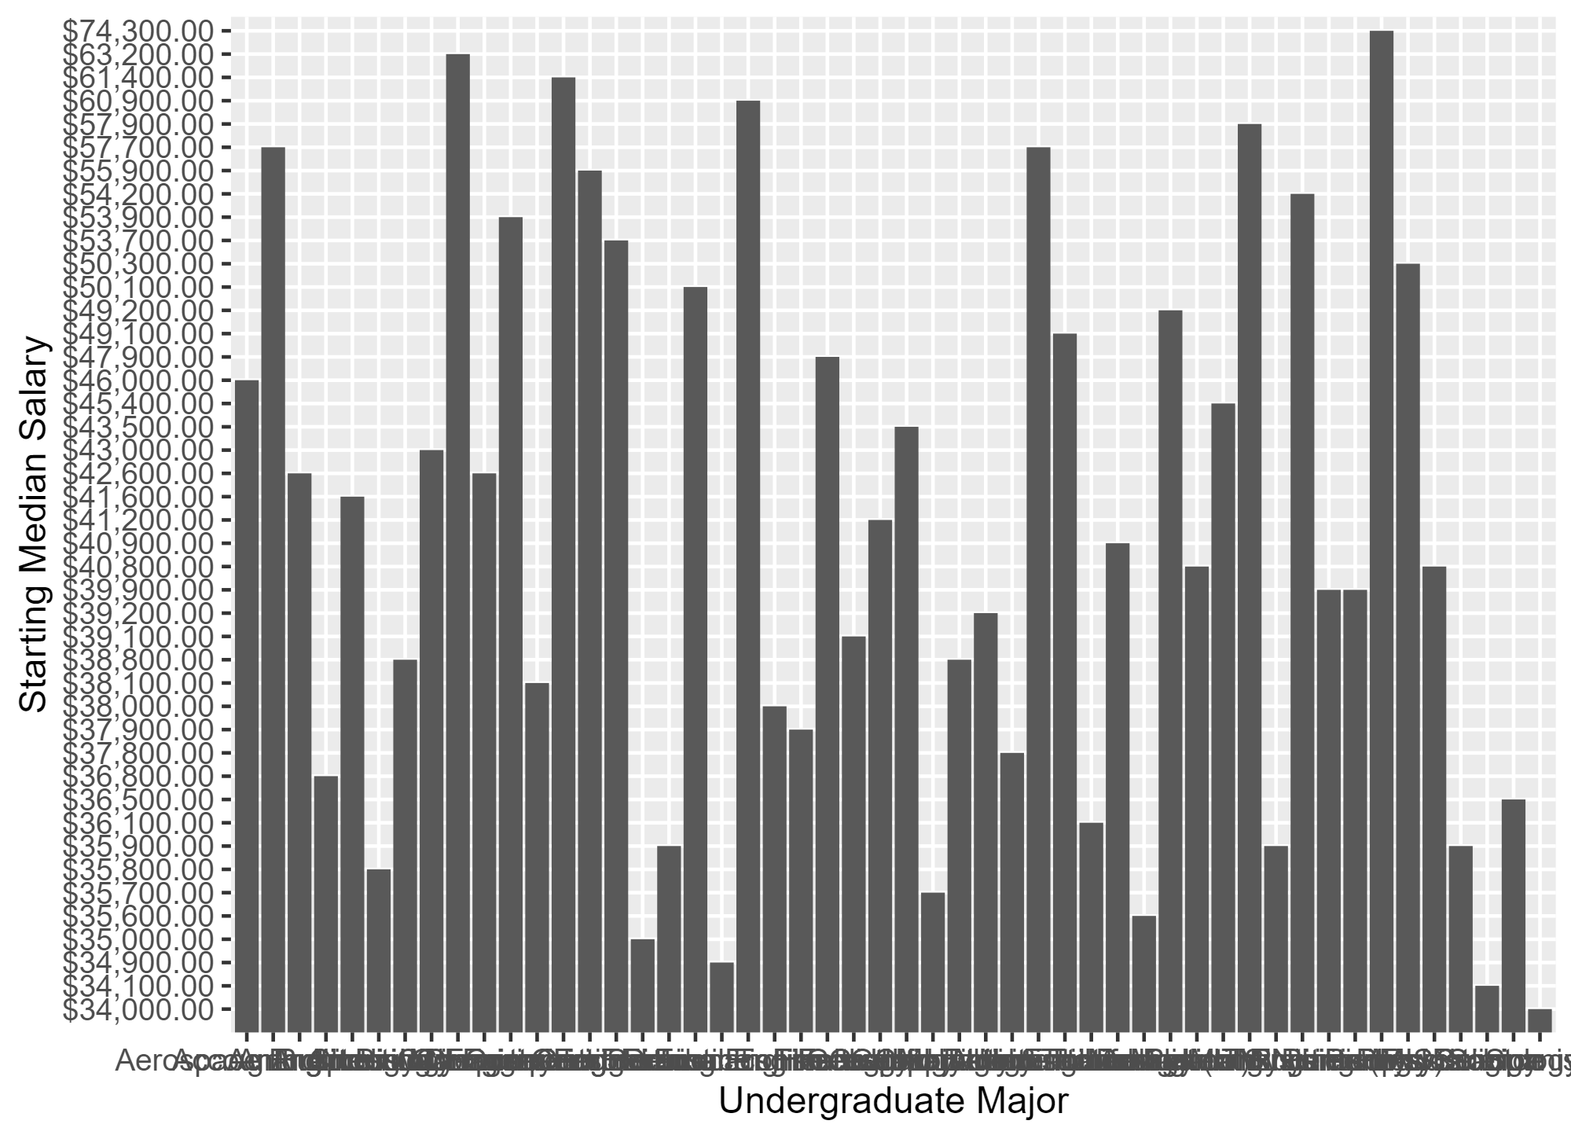

Slide 41
Exploring
Salaries by Major

Slide 42
Median Salary
By Major Category

Slide 43
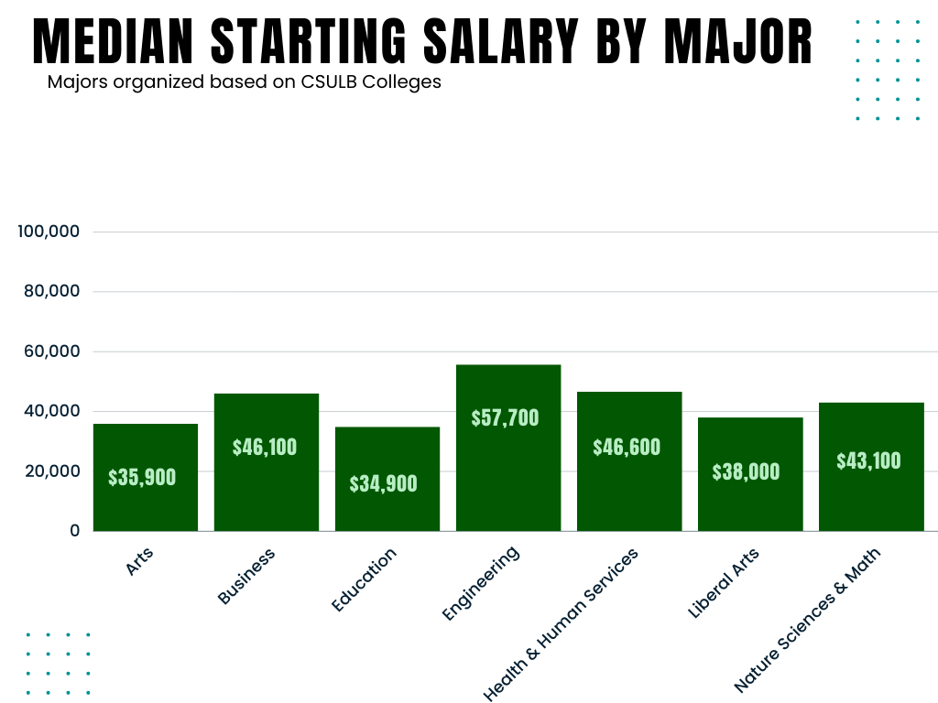
Early Career

Slide 44
Highest Paid Early Career Major
Engineering $57,700
Early Career
Lowest Paid Early Career Major
Education $34,900

Slide 45
Highest Paid Early Career Major
Engineering $57,700
Early Career
Lowest Paid Early Career Major
Education $34,900
Early Career Salary
Highest To Lowest
Engineering
Health & Human Services
Business
Nature Sciences & Math
Liberal Arts
Arts
Education

Slide 46
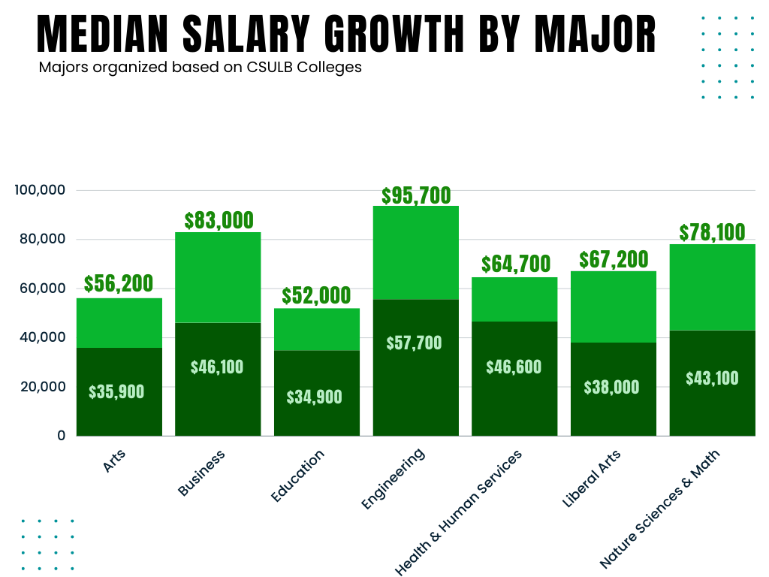
Mid-Career

Slide 47
Highest Paid Mid-Career Major
Engineering $95,700
Mid-Career
Lowest Paid Mid-Career Major
Education $52,000

Slide 48
Highest Paid Mid-Career Major
Engineering $95,700
Mid-Career
Lowest Paid Mid-Career Major
Education $52,000
Mid-Career Salary
Highest To Lowest
Engineering
Business
Nature Sciences & Math
Liberal Arts
Health & Human Services
Arts
Education

Slide 49
Early to Mid-Career Comparison
Highest Paid Early Career Major
Highest Paid Mid-Career Major
Engineering $95,700
Engineering $95,700
Lowest Paid Early Career Major
Lowest Paid Mid-Career Major
Education $34,900
Education $34,900
Early Career Salary
Highest To Lowest
Mid-Career Salary
Highest To Lowest
Engineering
Health & Human Services
Business
Nature Sciences & Math
Liberal Arts
Arts
Education
Engineering
Business
Nature Sciences & Math
Liberal Arts
Health & Human Services
Arts
Education

Slide 50
Analysis
Salaries by Major

Slide 51
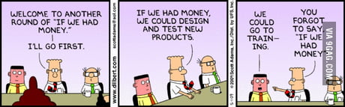

Takeaways from Salaries by Major Category
Engineers design and get that bag.
The suffering artist is statistically backed.
Teachers are underpaid (not news)
Humans are constantly changing - health & human service salaries ain’t.

Slide 52

Takeaways from Salaries by Major Category
Engineering related majors make the most money for their entire career.
Arts ranks the second lowest across the board.
Education ranks the lowest across the board.
Health & Human Services is best in the early career, but has low room for improvement.

Slide 53
Median Salary
By College Major

Slide 54
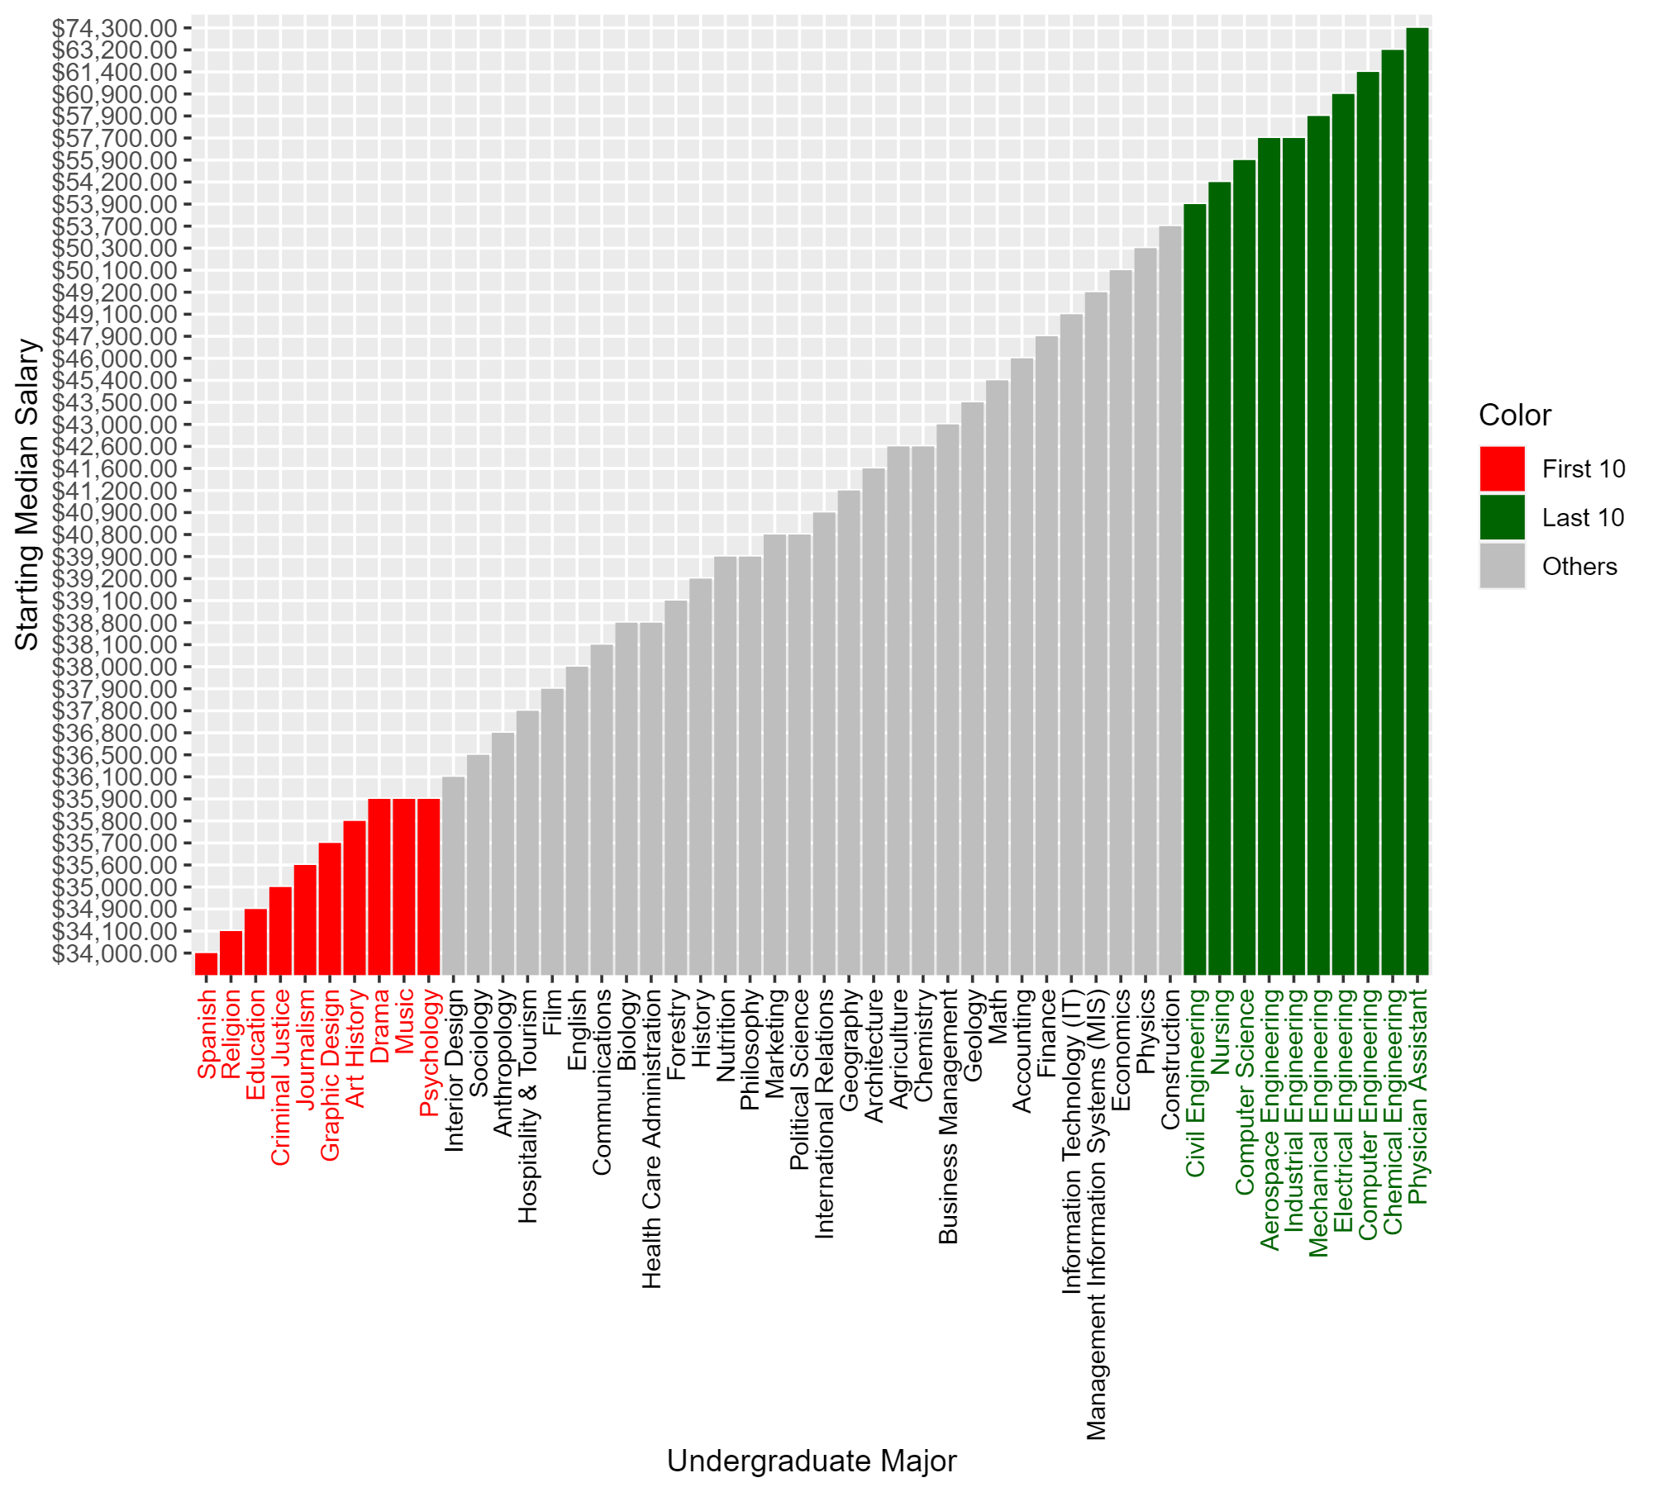
Top 10 Best
Starting Median Salaries:
Physician Assistant ($74,300)
Chemical Engineering ($63,200)
Computer Engineering ($61,400)
Electrical Engineering ($60,900)
Mechanical Engineering ($57,900)
Industrial Engineering ($57,700)
Aerospace Engineering ($57,700)
Computer Science ($55,900)
Nursing ($54,200)
Civil Engineering ($53,900)

Slide 55
Top 10 Worst
Starting Median Salaries:
Spanish ($34,000)
Religion ($34,100)
Education ($34,900)
Criminal Justice ($35,000)
Journalism ($35,600)
Graphic Design ($35,700)
Art History ($35,800)
Drama ($35,900)
Music ($35,900)
Psychology ($35,900)

Slide 56
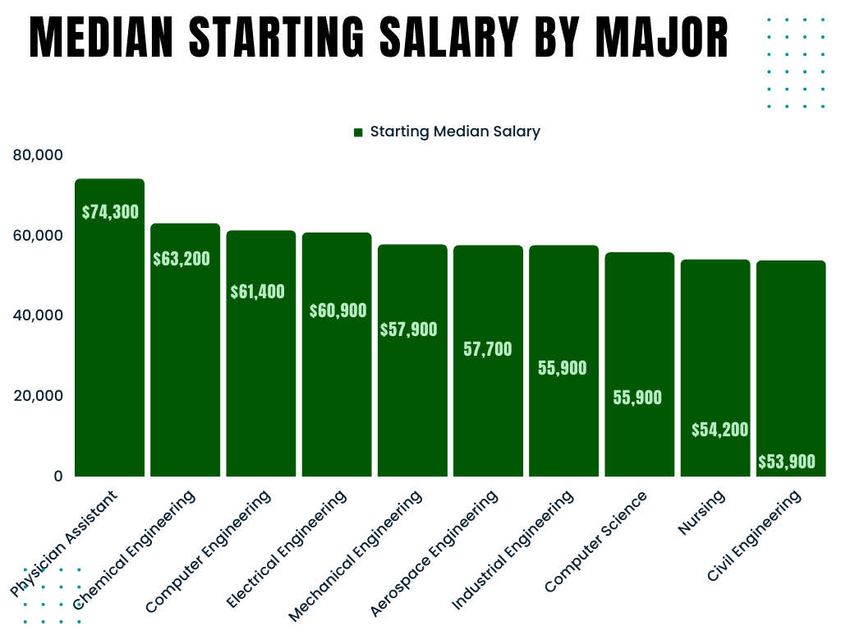
Highest Paid Early Career Major
Physician Assistant $74,300

Slide 57
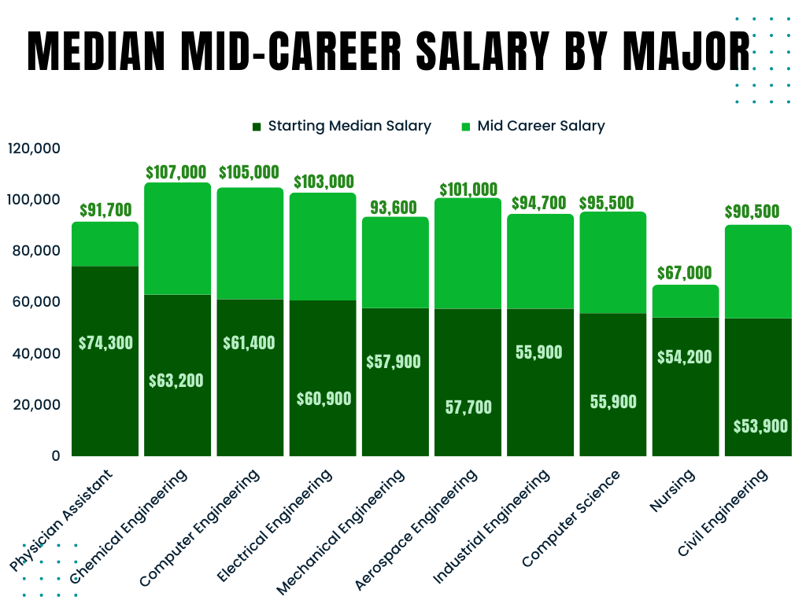
Highest Paid Mid Career Major
Chemical Engineering $107,000
Mid-Career Salary
Highest To Lowest
Chemical Engineering
Computer Engineering
Electrical Engineering
Aerospace Engineering
Computer Science
Industrial Engineering
Mechanical Engineering
Physician Assistant
Civil Engineering
Nursing

Slide 58
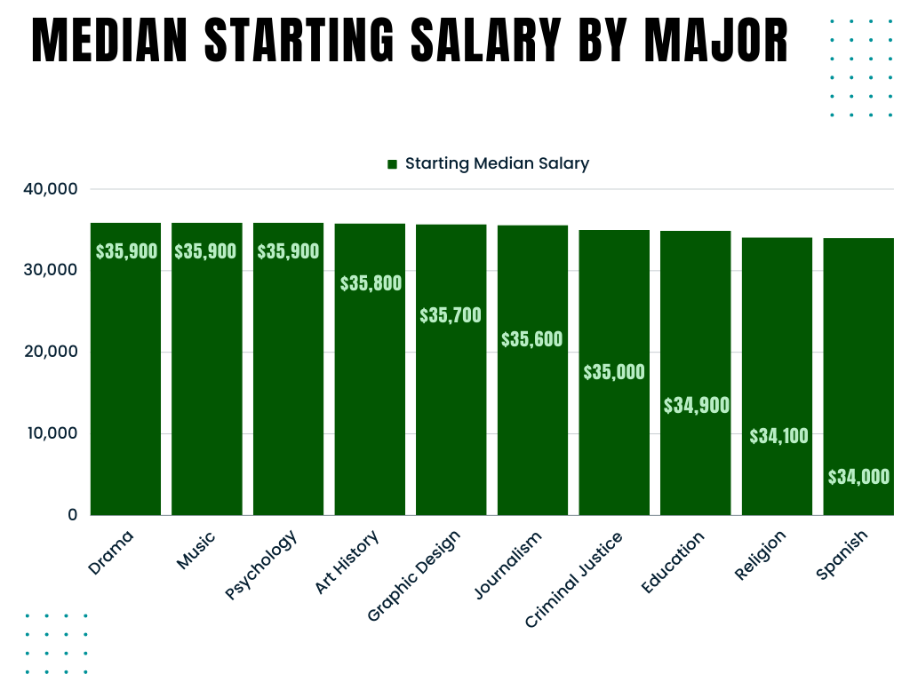
Lowest Paid Early Career Major
Spanish $34,000

Slide 59
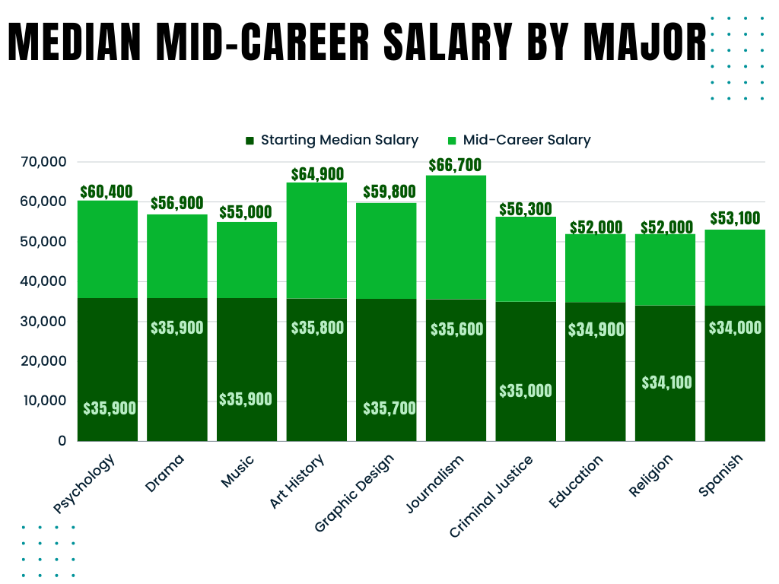
Lowest Paid Mid Career Major
Education
Mid-Career Salary
Lowest To Highest
Education
Religion
Spanish
Interior Design
Music
Nutrition
Criminal Justice
Drama
Hospitality & Tourism
Sociology

Slide 60
Early to Mid-Career Comparison
Highest Paid Early Career Major
Highest Paid Mid-Career Major
Physical Assistant $74,300
Chemical Engineering $107,000
Lowest Paid Early Career Major
Lowest Paid Mid-Career Major
Spanish $34,000
Education & Religion $52,000
Early Career Salary
Highest To Lowest
Mid-Career Salary
Highest To Lowest
Physician Assistant
Chemical Engineering
Computer Engineering
Electrical Engineering
Mechanical Engineering
Aerospace Engineering
Industrial Engineering
Computer Science
Nursing
Civil Engineering
Chemical Engineering
Computer Engineering
Electrical Engineering
Aerospace Engineering
Economics
Physics
Computer Science
Industrial Engineering
Mechanical Engineering
Math

Slide 61
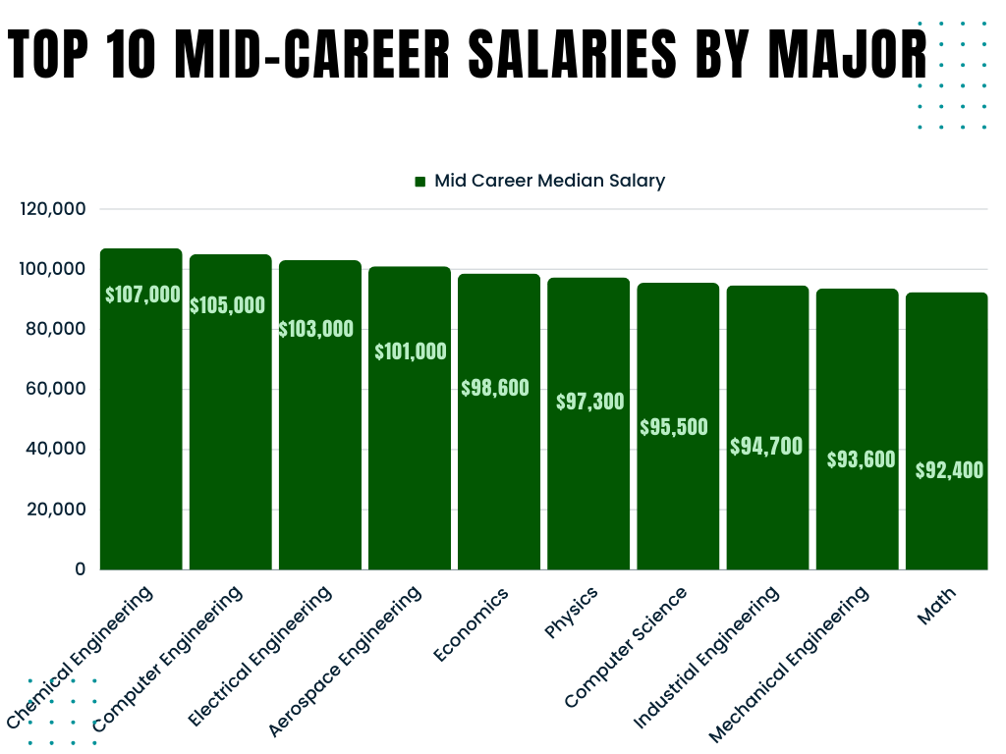
Top 10 Mid Career Salaries by Major
Mid-Career Salary
Highest To Lowest
Chemical Engineering
Computer Engineering
Electrical Engineering
Aerospace Engineering
Economics
Physics
Computer Science
Industrial Engineering
Mechanical Engineering
Math
Early Career Salary
(They leave the Top 10)
Physician Assistant
9. Nursing
10. Civil Engineering

Slide 62
Analysis
Salaries by Major

Slide 63
Takeaways from Salaries by College Major
Engineering Consistency: Engineering fields offer strong earning potential, both early & mid career
Passion vs. Paycheck: Pursuing passion may lead to lower initial salaries. For example, majors like spanish & religion have lower starting median salaries, showing the trade-off between pursuing personal interests and financial gain.
Psychology’s Paradox: Psychology majors, despite exploring human behavior, often face lower earnings, showcasing the disparity between societal important and financial reward.

Slide 64
Takeaways from Salaries by College Major
Physician Assistants, despite starting with a high salary, they experience a small salary increase in mid-career compared to other fields, showing early peak earnings.
Civil Engineers, while maintaining competitive mid-career salaries, leaves the top 10. Because civil engineers work in various sectors, including construction, transportation, infrastructure etc, their mid career salaries can vary based off their specific area of expertise.

Slide 65
Takeaways from Salaries by College Major
Analytical Skills are Valued. Several majors on the highest earning mid-career salaries (economics, computer science, and math, emphasize the significance of strong analytical and problem-solving skills in the job market)
Chemical engineering having a high early career salary as well as the highest mid-career salary showcases the long-term financial benefits of this field.
Economics is the only non STEM major in the top 10 of mid-career salaries

Slide 66
Final Takeaways
Northeastern Colleges average highest starting and mid-career salaries
Ivy Leagues & Engineering schools have the highest starting and mid-career salaries. State schools are last
Engineering majors have the highest median salary across their entire career.
Chemical engineering and Computer engineering take the top 1 and 2 spots, respectively.
Education, Arts, and Liberal Art majors statistically make the least starting and mid-career salaries regardless of what college attended

Slide 67

Money is an illusion
It’s not even backed by gold anymore
Follow your dreams kids
BOTTOM TEXT

